Slide 1
Statistics
Inferential Statistics
Descriptive Statistics
Methods of organizing, summarizing, and presenting data in an informative way.
Americans spent an average of $143.56 on Valentine’s Day–related gifts in 2018. About 15 percent of Americans purchased gifts cards for Valentine’s Day. In addition, they spent an average of $5.50 on gifts for their pets.
The process of sampling from a population with the objective of estimating properties of a population is called inferential statistics.
Television networks constantly monitor the popularity of their programs by hiring Nielsen and other organizations to sample the preferences of TV viewers. During the week of December 3, 2018, The Tonight Show Starring Jimmy Fallon was viewed by 2.26 million people in the 18–49 age. The Late Show with Stephen Colbert led the age group with 3.23 million viewers.These program ratings are used to make decisions about advertising rates and whether to continue or cancel a program.

Slide 2
Qualitative Data-Qualitative or Categorical Data is data that can’t be measured or counted in the form of numbers. These types of data are sorted by category, not by number. That’s why it is also known as Categorical Data.
Nominal Data
Ordinal Data
Nominal Data is used to label variables without any order or quantitative value. The color of hair can be considered nominal data, as one color can’t be compared with another color.
With the help of nominal data, we can’t do any numerical tasks or can’t give any order to sort the data. These data don’t have any meaningful order; their values are distributed into distinct categories.
Examples of Nominal Data :
Colour of hair (Blonde, red, Brown, Black, etc.)
Marital status (Single, Widowed, Married)
Nationality (Indian, German, American)
Gender (Male, Female, Others)
Eye Color (Black, Brown, etc.)
Ordinal data have natural ordering where a number is present in some kind of order by their position on the scale. These data are used for observation like customer satisfaction, happiness, etc., but we can’t do any arithmetical tasks on them.
Ordinal data is qualitative data for which their values have some kind of relative position.
Examples of Ordinal Data :
When companies ask for feedback, experience, or satisfaction on a scale of 1 to 10
Letter grades in the exam (A, B, C, D, etc.)
Ranking of people in a competition (First, Second, Third, etc.)
Economic Status (High, Medium, and Low)
Education Level (Higher, Secondary, Primary)

Slide 3
Quantitative Data-Quantitative data can be expressed in numerical values, making it countable and including statistical data analysis. These kinds of data are also known as Numerical data.
Discrete
Continuous
The term discrete means distinct or separate. The discrete data contain the values that fall under integers or whole numbers. The total number of students in a class is an example of discrete data. These data can’t be broken into decimal or fraction values. The discrete data are countable and have finite values
Examples of Discrete Data :
Total numbers of students present in a class
Numbers of employees in a company
The total number of players who participated in a competition
Days in a week
Continuous data are in the form of fractional numbers. It can be the version of an android phone, the height of a person, the length of an object, etc. Continuous data represents information that can be divided into smaller levels. The continuous variable can take any value within a range.
Examples of Continuous Data :
Height of a person
Speed of a vehicle
“Time-taken” to finish the work
Wi-Fi Frequency
Market share price

Slide 4
Range, Variance and Standard Deviation
Range, variance, and standard deviation all measure the spread or variability of a data set in different ways. The range is easy to calculate—it's the difference between the largest and smallest data points in a set. Standard deviation is the square root of the variance. Standard deviation is a measure of how spread out the data is from its mean.
Population variance is a measure of how spread out a group of data points is. Specifically, it quantifies the average squared deviation from the mean. So, if all data points are very close to the mean, the variance will be small; if data points are spread out over a wide range, the variance will be larger.
Population standard deviation is a measure of how much variation there is among individual data points in a population. It's a way of quantifying how spread out the data is from its mean. A small standard deviation means that the data points are generally close to the mean, while a large standard deviation means that the data is more dispersed.

Slide 5
Co-efficient of Variation (CV) vs. Standard Deviation
The standard deviation is a statistic that measures the dispersion of a data set relative to its mean. It is used to determine the spread of values in a single data set rather than to compare different units.
When we want to compare two or more data sets, the co-efficient of variation is used. The CV is the ratio of the standard deviation to the mean. And because it’s independent of the unit in which the measurement was taken, it can be used to compare data sets with different units or widely different means.

Slide 6
Coefficient of Skewness
Coefficient of skewness is one way to measure the skewness of a distribution. The coefficient of skewness can be defined as a measure that is used to determine the strength and direction of the skewness of a sample distribution by using descriptive statistics such as the mean, median, or mode. If the curve of a normal distribution is distorted towards the left or right then it is known as a skewed distribution. The most important measure of skewness is the coefficient of skewness that was given by Karl Pearson. It is also known as Pearson's coefficient of skewness.
Coefficient of Skewness Interpretation
Depending upon the value of the coefficient of skewness, the following inferences can be drawn about a distribution.
If the mean exceeds the mode and median (Mode < Median < Mean) then the distribution is positively skewed. In other words, if the coefficient of skewness is positive then the distribution is skewed to the right.
If the mode exceeds the median and mean (Mean < Median < Mode) then the distribution is negatively skewed. Thus, the coefficient of skewness will be negative and the distribution will be skewed to the left.
If the value of the mean, median, and mode are equal then the distribution is a normal distribution and the coefficient of skewness will be 0.

Slide 7
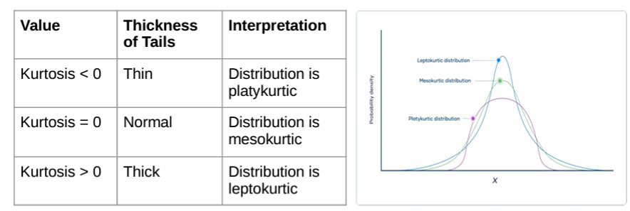
Kurtosis
Kurtosis is a statistic that measures the extent to which a distribution contains outliers. It assesses the propensity of a distribution to have extreme values within its tails. There are three kinds of kurtosis: leptokurtic, platykurtic, and mesokurtic. Statisticians define these types relative to the normal distribution. Higher kurtosis values indicate that the distribution has more outliers falling relatively far from the mean. Distributions with smaller values have a lower tendency for producing extreme values.
For instance, statisticians describe leptokurtic distributions as having higher kurtosis than the normal distribution. These distributions have “heavy tails,” indicating that they have relatively long tails that contain more outliers. Conversely, platykurtic distributions have “light tails” that are shorter and include fewer extreme values. Below, I’ll graph all three types for comparison.

Slide 8
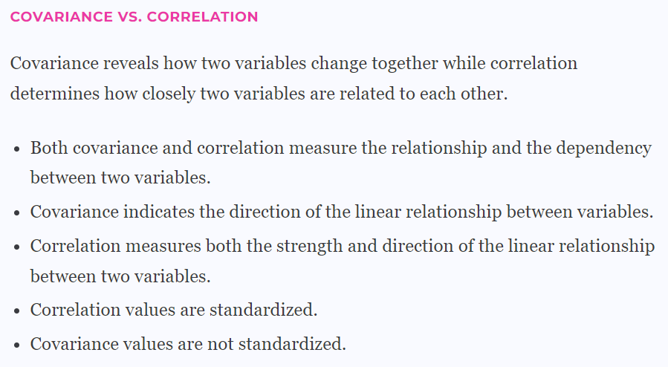
Covariance and Correlation
Covariance and Correlation are very helpful in understanding the relationship between two continuous variables.
Covariance tells whether both variables vary in the same direction (positive covariance) or in the opposite direction (negative covariance). There is no meaning of covariance numerical value only sign is useful.
Whereas Correlation explains the change in one variable leads how much proportion change in the second variable. Correlation varies between -1 to +1. If the correlation value is 0 then it means there is no Linear Relationship between variables however other functional relationship may exist.

Slide 9
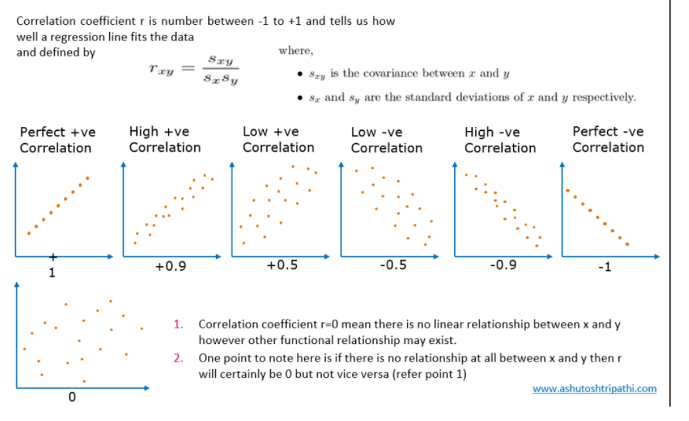

Slide 10
What are Exhaustive Events?
All possible outcomes of an experiment constitute exhaustive events as one of them will definitely occur. Now, exhaustive events may or may not be equally likely events, i.e., it is not necessary for events to have equal probability to be exhaustive.
Let us consider an example of exhaustive events. There are six possible outcomes when rolling a die which is {1, 2, 3, 4, 5, 6}. Now, if we roll a die, one of these six outcomes will definitely occur. Hence, all these six outcomes are exhaustive events. Therefore, we can say that the union of the exhaustive events gives the entire sample space.
Let us change the events for rolling a die and verify if the events are exhaustive and constitute the sample space. When rolling a die, let A be the event of getting a prime number, let B be the event of getting a composite number and C be the event of getting the number 1 (as 1 is neither prime nor composite and it is one of the possible outcomes). Now, we have A = {2, 3, 5}, B = {4, 6}, C = {1}. Now, when we roll a die, one of the six numbers - 1, 2, 3, 4, 5, 6 will occur which implies one of the events A, B, C will occur. Hence, these are exhaustive events. Also, A U B U C = {1, 2, 3, 4, 5, 6} = Sample Space.

Slide 11
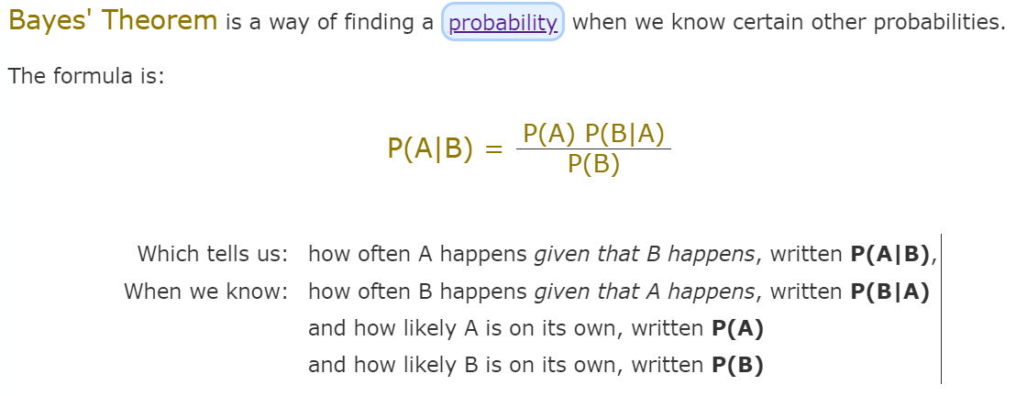
Bayes’ Theorem

Slide 12
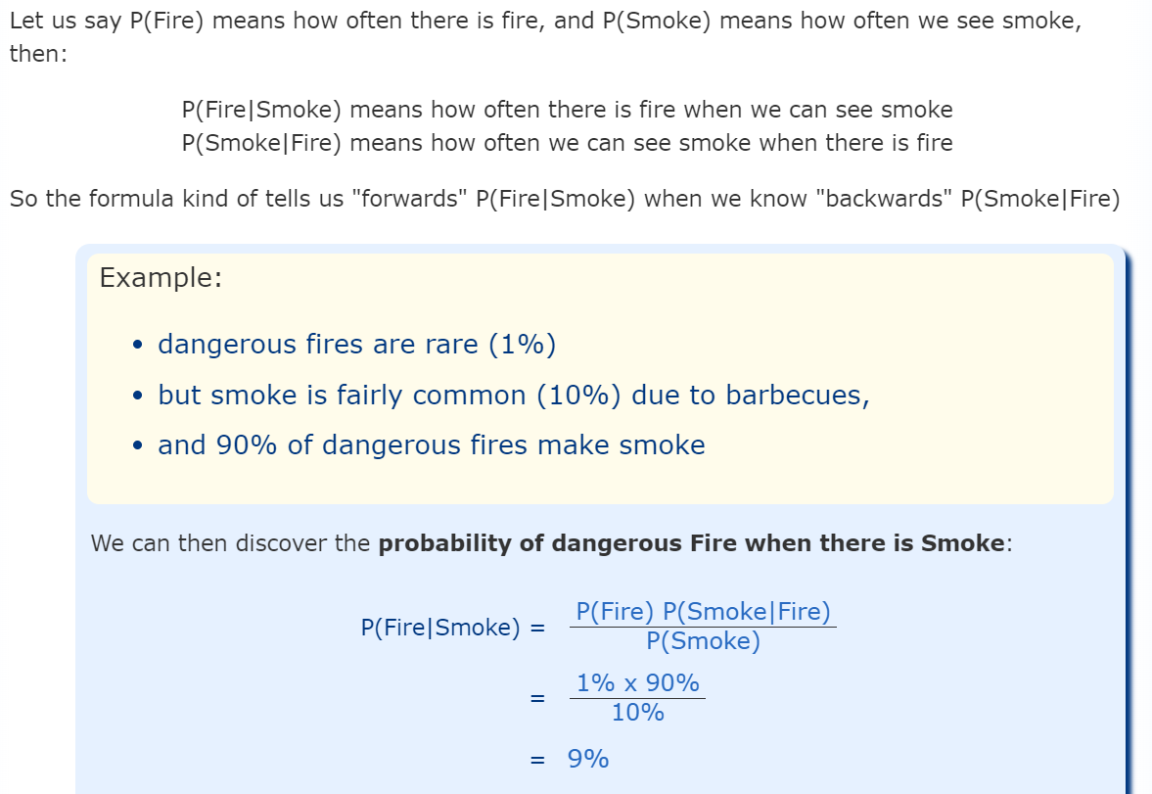
Bayes’ Theorem

Slide 13
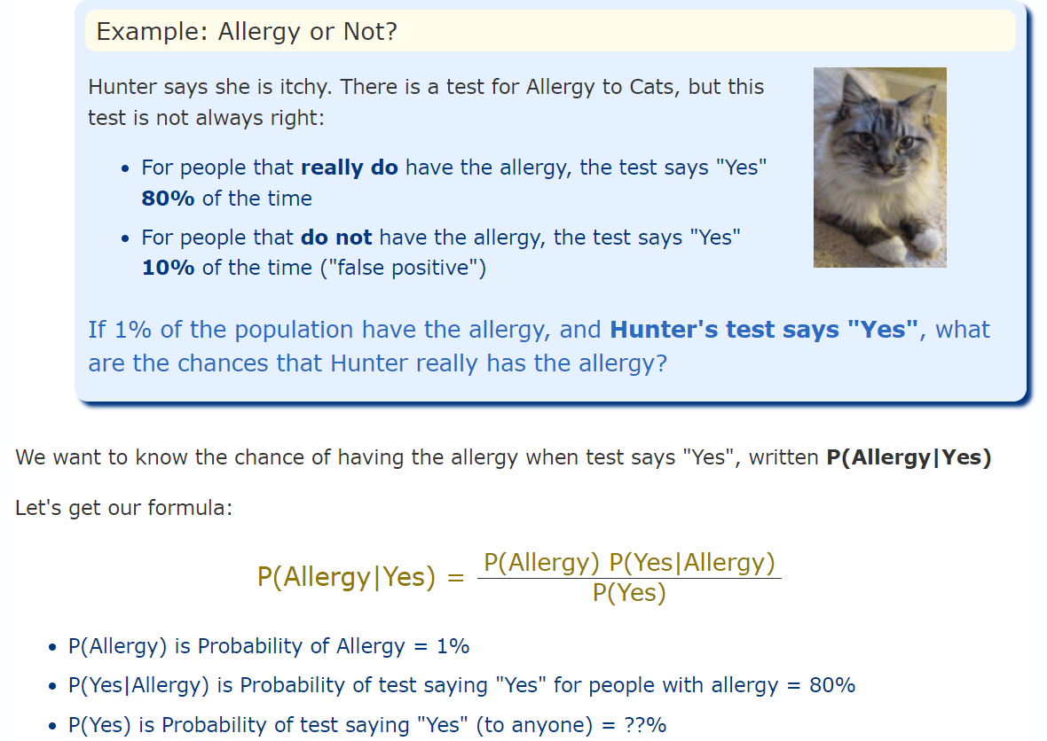
Bayes’ Theorem-With 2 A Cases-Cat Allergy-we have two possible cases for "A", such as Pass/Fail (or Yes/No etc)

Slide 14
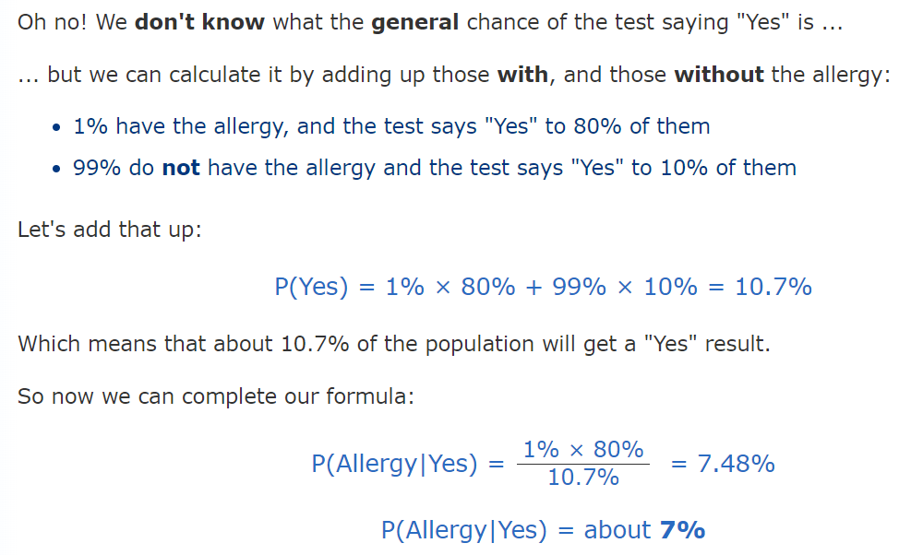

Bayes’ Theorem-With 2 A Cases-Cat Allergy

Slide 15
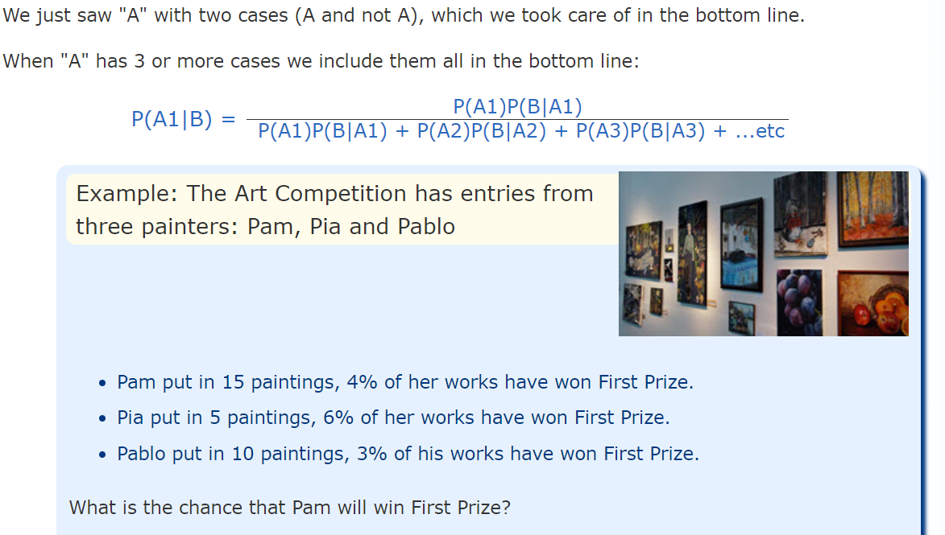
Bayes’ Theorem-With 3 or More A Cases

Slide 16
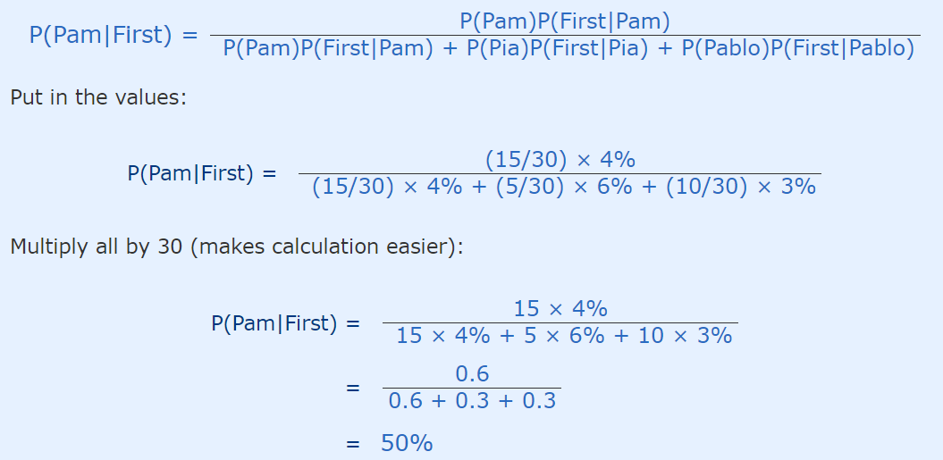
Bayes’ Theorem-With 3 or More A Cases

Slide 17
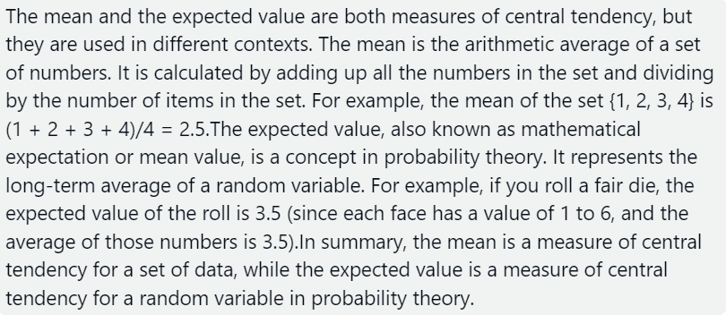
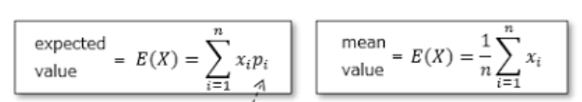
Difference between Mean and Expected Value

Slide 18
Random Variable
A random variable is a variable whose value is unknown or a function that assigns values to each of an experiment's outcomes. Random variables are often designated by letters and can be classified as discrete, which are variables that have specific values, or continuous, which are variables that can have any values within a continuous range.
In probability and statistics, random variables are used to quantify outcomes of a random occurrence, and therefore, can take on many values. Random variables are required to be measurable and are typically real numbers. For example, the letter X may be designated to represent the sum of the resulting numbers after three dice are rolled. In this case, X could be 3 (1 + 1+ 1), 18 (6 + 6 + 6), or somewhere between 3 and 18, since the highest number of a die is 6 and the lowest number is 1.
In the corporate world, random variables can be assigned to properties such as the average price of an asset over a given time period, the return on investment after a specified number of years, the estimated turnover rate at a company within the following six months, etc.

Slide 19
Example of a Random Variable
A typical example of a random variable is the outcome of a coin toss. Consider a probability distribution in which the outcomes of a random event are not equally likely to happen. If the random variable Y is the number of heads we get from tossing two coins, then Y could be 0, 1, or 2. This means that we could have no heads, one head, or both heads on a two-coin toss.
However, the two coins land in four different ways: TT, HT, TH, and HH. Therefore, the P(Y=0) = 1/4 since we have one chance of getting no heads (i.e., two tails [TT] when the coins are tossed). Similarly, the probability of getting two heads (HH) is also 1/4. Notice that getting one head has a likelihood of occurring twice: in HT and TH. In this case, P (Y=1) = 2/4 = 1/2.
Upper case letters such as X or Y denote a random variable. Lower case letters like x or y denote the value of a random variable.

Slide 20
Discrete and Continuous Random Variable
Discrete Random Variables
Discrete random variables take on a countable number of distinct values. Consider an experiment where a coin is tossed three times. If X represents the number of times that the coin comes up heads, then X is a discrete random variable that can only have the values 0, 1, 2, or 3 (from no heads in three successive coin tosses to all heads). No other value is possible for X.
Continuous Random Variables
Continuous random variables can represent any value within a specified range or interval and can take on an infinite number of possible values. An example of a continuous random variable would be an experiment that involves measuring the amount of rainfall in a city over a year or the average height of a random group of 25 people.
Drawing on the latter, if Y represents the random variable for the average height of a random group of 25 people, you will find that the resulting outcome is a continuous figure since height may be 5 ft or 5.01 ft or 5.0001 ft. Clearly, there is an infinite number of possible values for height.

Slide 21
Mean and Variance of Bernoulli Distribution
Mean of Bernoulli Distribution Proof:
We know that for X,
P(X = 1) = p
P(X = 0) = q
E[X] = P(X = 1) . 1 + P(X = 0) . 0
E[X] = p . 1 + q . 0
E[X] = p
Thus, the mean or expected value of a Bernoulli distribution is given by E[X] = p.
Variance of Bernoulli Distribution Proof:
The variance can be defined as the difference of the mean of X² and the square of the mean of X. Mathematically this statement can be written as follows:
Var[X] = E[X²] - (E[X])²
Using the properties of E[X²], we get,
E[X²] = ∑x^2P(X=x)
E[X²] = 1² . p + 0² . q = p
Substituting this value in Var[X] = E[X²] - (E[X])² we have
Var[X] = p - p²
= p(1 - p)
= p . q
Hence, the variance of a Bernoulli distribution is Var[X] = p(1 - p) = p . q

Slide 22
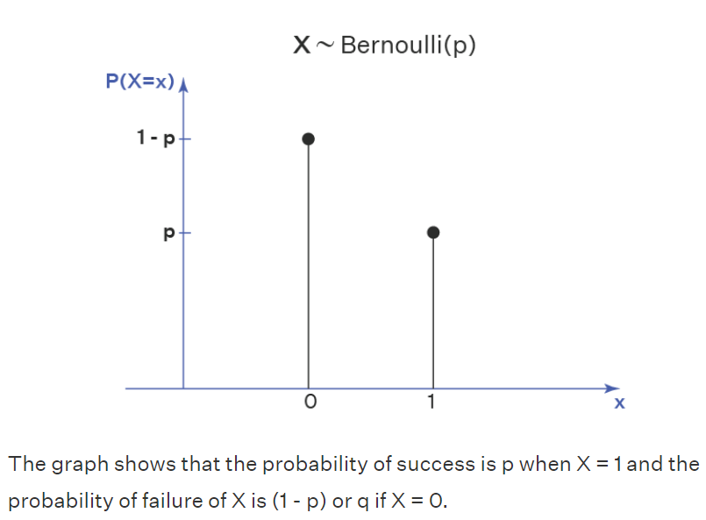
Bernoulli Distribution Graph

Slide 23
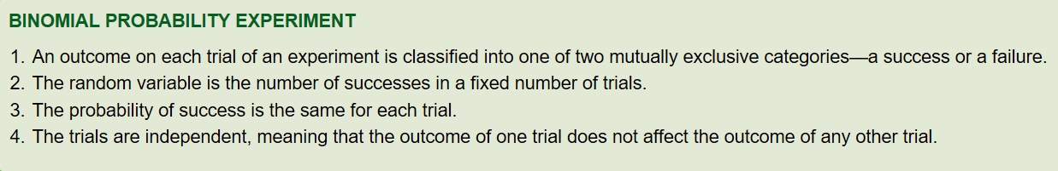
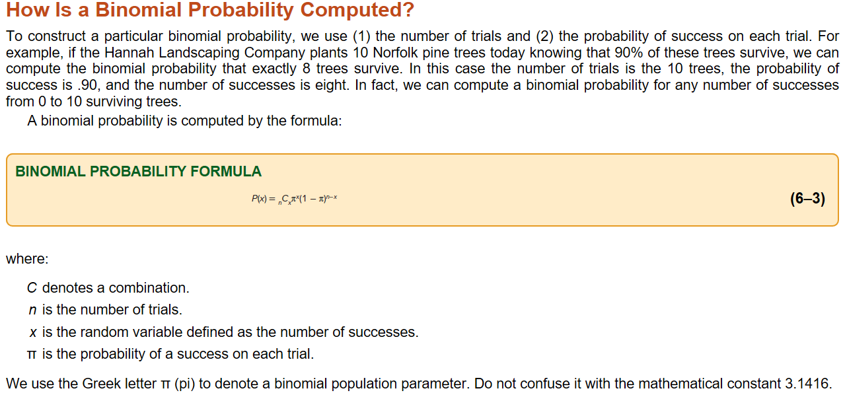
Binomial Probability

Slide 24
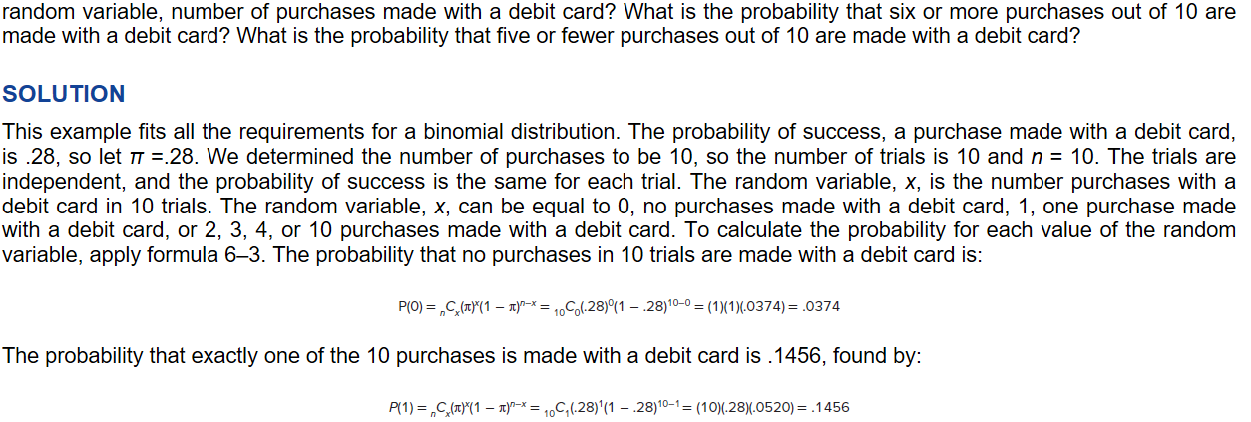
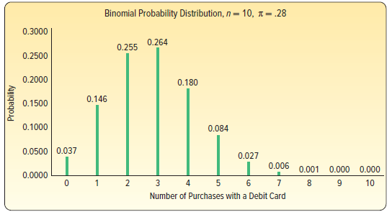
Binomial Probability Example

Slide 25
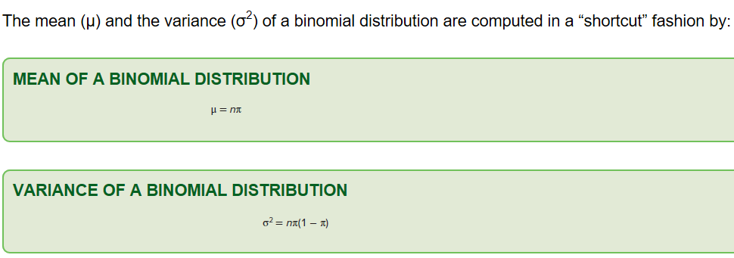
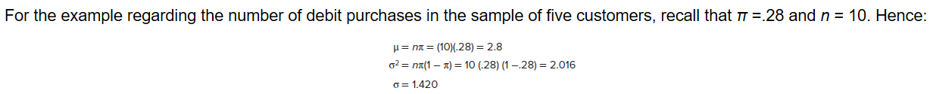
Binomial Probability Mean and variance

Slide 26
Poisson Probability Distribution
The Poisson distribution is a probability distribution that describes the number of events that occur within a fixed interval of time or space, given a certain average rate of occurrence and under certain assumptions.
The Poisson distribution is often used in scenarios where events occur randomly and independently, and the events are rare within the given interval. Some common examples of situations that can be modeled using the Poisson distribution include:
Phone Calls: The number of phone calls received by a call center in an hour.
Accidents: The number of accidents occurring at a specific intersection in a day.
Typographical Errors: The number of typographical errors on a page of a book.
Radioactive Decay: The number of particles decaying in a certain substance over a fixed period.

Slide 27
Poisson Probability Distribution
The Poisson distribution is characterized by a single parameter, often denoted as λ (lambda), which represents the average rate of events occurring in the interval. The probability mass function (PMF) of the Poisson distribution is given by the formula:
P(X = k) = (e^(-λ) * λ^k) / k!
Where:
P(X = k) is the probability of observing exactly k events in the interval.
e is the base of the natural logarithm (approximately 2.71828).
λ is the average rate of events.
k is the number of events observed.
k! represents the factorial of k (k! = k * (k - 1) * (k - 2) * ... * 2 * 1).
It's important to note that the Poisson distribution is most suitable for situations where events are rare and independent. If events become more frequent or are not independent, other distributions like the binomial distribution or the normal distribution might be more appropriate.
In practice, the Poisson distribution can be useful for predicting the likelihood of certain events occurring within a given time or space interval based on historical data or assumptions about the average rate of occurrence.

Slide 28
Poisson Probability Distribution-Example
Example: Customer Arrivals at a Café Suppose you run a small café and you're interested in modeling the number of customers who arrive during the morning rush hour (from 8:00 AM to 10:00 AM). On average, you've observed that around 5 customers arrive during this time period.
You can use the Poisson distribution to answer questions like: What's the probability of having exactly 3 customers during this time frame? Or what's the probability of having more than 7 customers?
Using the Poisson distribution formula: P(X = k) = (e^(-λ) * λ^k) / k!
Where:
λ (lambda) = 5 (average number of customer arrivals during the morning rush hour) k = the number of customers we're interested in
Let's calculate a few probabilities:
Probability of having exactly 3 customers (k = 3): P(X = 3) = (e^(-5) * 5^3) / 3! ≈ 0.1404
Probability of having more than 7 customers: P(X > 7) = 1 - P(X ≤ 7) Calculate P(X ≤ 7) by adding up probabilities for k = 0 to 7: P(X ≤ 7) = P(X = 0) + P(X = 1) + P(X = 2) + ... + P(X = 7) Then, subtract from 1 to get P(X > 7).
This example demonstrates how the Poisson distribution can be used to estimate the likelihood of specific event counts occurring based on an average rate. Remember that the Poisson distribution is appropriate when events are rare and independent, which might not be the case if the arrival rate becomes very high or if customer arrivals are influenced by external factors.

Slide 29
Poisson Probability Distribution-Mean and Variance
For a Poisson distribution with parameter λ (lambda), the mean (μ) and variance (σ²) are given by the same parameter λ:
Mean (μ) = λ Variance (σ²) = λ
In mathematical terms, this relationship is expressed as follows:
μ = λ σ² = λ
This means that the average number of events in a Poisson distribution is equal to its variance. This relationship is a unique characteristic of the Poisson distribution. It also makes sense intuitively, as the Poisson distribution is based on the assumption that events occur at a constant average rate, and both the mean and variance reflect this rate of occurrence.
So, in the example we discussed earlier with the café's customer arrivals, if the average number of customers arriving during the morning rush hour is λ = 5, then both the mean and the variance of customer arrivals during that time period would be 5.

Slide 30
Continuous Probability Distribution
A continuous probability distribution usually results from measuring something, such as the distance from the dormitory to the classroom, the weight of an individual, or the amount of bonus earned by CEOs. As an example, at Dave’s Inlet Fish Shack flounder is the featured, fresh-fish menu item. The distribution of the amount of flounder sold per day has a mean of 10.0 pounds per day and a standard deviation of 3.0 pounds per day. This distribution is continuous because Dave, the owner, “measures” the amount of flounder sold each day. It is important to realize that a continuous random variable has an infinite number of values within a particular range. So, for a continuous random variable, probability is for a range of values.
Uniform Probability Distributions:
The uniform probability distribution is the simplest distribution for a continuous random variable. This distribution is rectangular in shape and is completely defined by its minimum and maximum values. Here are some examples that follow a uniform distribution.
The sales of gasoline at the Kwik Fill in Medina, New York, follow a uniform distribution that varies between 2,000 and 5,000 gallons per day. The random variable is the number of gallons sold per day and is continuous within the interval between 2,000 gallons and 5,000 gallons.
Volunteers at the Grand Strand Public Library prepare federal income tax forms. The time to prepare form 1040-EZ follows a uniform distribution over the interval between 10 minutes and 30 minutes. The random variable is the number of minutes to complete the form, and it can assume any value between 10 and 30.

Slide 31
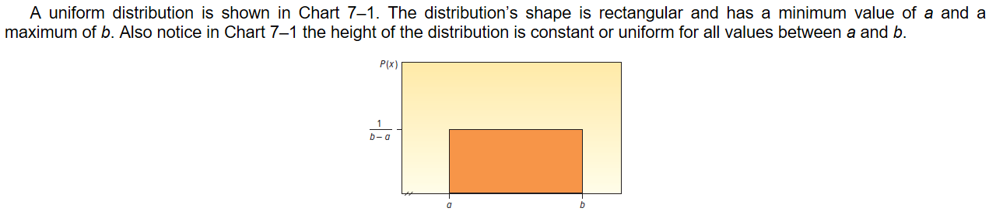
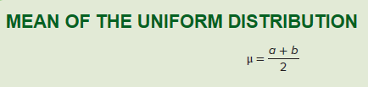

Continuous Uniform Probability Distributions:

Slide 32
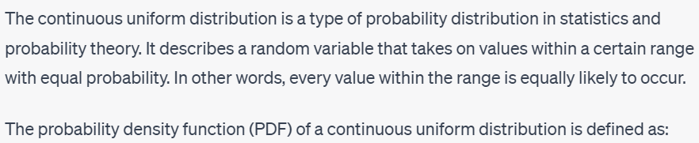
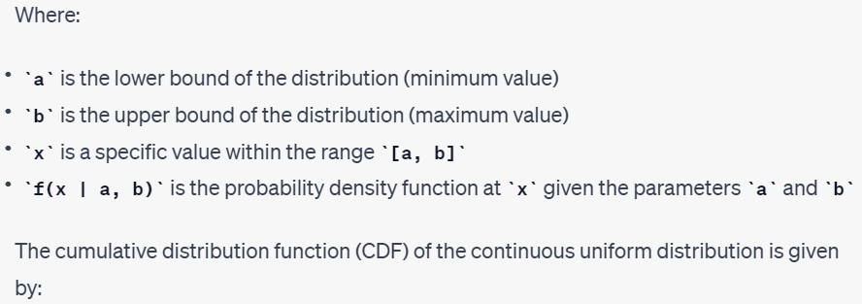
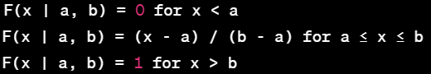
Uniform Probability Distributions:

Slide 33
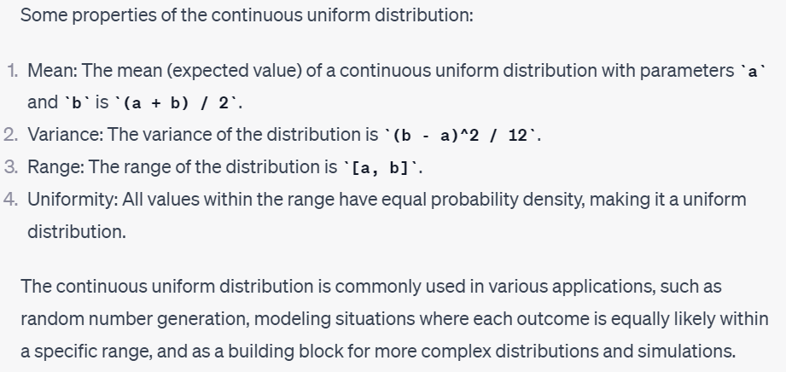
Properties of Uniform Probability Distributions

Slide 34
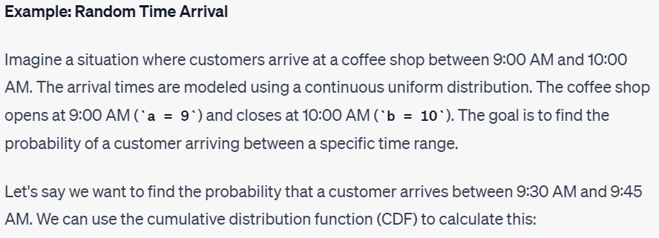
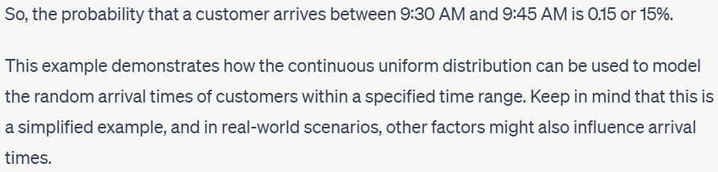
Uniform Probability Distributions: Example
F(9.45 | 9, 10) - F(9.30 | 9, 10) = (9.45 - 9) / (10 - 9) - (9.30 - 9) / (10 - 9) = 0.45 - 0.30 = 0.15

Slide 35
Sampling
To draw valid conclusions from your results, you have to carefully decide how you will select a sample that is representative of the group as a whole. This is called a sampling method. There are two primary types of sampling methods that you can use in your research:
Probability sampling involves random selection, allowing you to make strong statistical inferences about the whole group.
Non-probability sampling involves non-random selection based on convenience or other criteria, allowing you to easily collect data.

Slide 36
Probability Sampling
Simple random sampling
In a simple random sample, every member of the population has an equal chance of being selected. Your sampling frame should include the whole population. To conduct this type of sampling, you can use tools like random number generators or other techniques that are based entirely on chance.
Example: You want to select a simple random sample of 1000 employees of a social media marketing company. You assign a number to every employee in the company database from 1 to 1000, and use a random number generator to select 100 numbers.
Stratified sampling
Stratified sampling involves dividing the population into subpopulations that may differ in important ways. It allows you draw more precise conclusions by ensuring that every subgroup is properly represented in the sample.
To use this sampling method, you divide the population into subgroups (called strata) based on the relevant characteristic (e.g., gender identity, age range, income bracket, job role).
Based on the overall proportions of the population, you calculate how many people should be sampled from each subgroup. Then you use random or systematic sampling to select a sample from each subgroup.
Example: The company has 800 female employees and 200 male employees. You want to ensure that the sample reflects the gender balance of the company, so you sort the population into two strata based on gender. Then you use random sampling on each group, selecting 80 women and 20 men, which gives you a representative sample of 100 people.

Slide 37
Probability Sampling
Systematic sampling
Systematic sampling is similar to simple random sampling, but it is usually slightly easier to conduct. Every member of the population is listed with a number, but instead of randomly generating numbers, individuals are chosen at regular intervals.
Example: All employees of the company are listed in alphabetical order. From the first 10 numbers, you randomly select a starting point: number 6. From number 6 onwards, every 10th person on the list is selected (6, 16, 26, 36, and so on), and you end up with a sample of 100 people.
Cluster sampling
Cluster sampling also involves dividing the population into subgroups, but each subgroup should have similar characteristics to the whole sample. Instead of sampling individuals from each subgroup, you randomly select entire subgroups.
If it is practically possible, you might include every individual from each sampled cluster. If the clusters themselves are large, you can also sample individuals from within each cluster using one of the techniques above. This is called multistage sampling.
This method is good for dealing with large and dispersed populations, but there is more risk of error in the sample, as there could be substantial differences between clusters. It’s difficult to guarantee that the sampled clusters are really representative of the whole population.
Example: The company has offices in 10 cities across the country (all with roughly the same number of employees in similar roles). You don’t have the capacity to travel to every office to collect your data, so you use random sampling to select 3 offices – these are your clusters.

Slide 38
Non-Probability Sampling Methods
Convenience sampling
A convenience sample simply includes the individuals who happen to be most accessible to the researcher.
This is an easy and inexpensive way to gather initial data, but there is no way to tell if the sample is representative of the population, so it can’t produce generalizable results. Convenience samples are at risk for both sampling bias and selection bias.
Example: You are researching opinions about student support services in your university, so after each of your classes, you ask your fellow students to complete a survey on the topic. This is a convenient way to gather data, but as you only surveyed students taking the same classes as you at the same level, the sample is not representative of all the students at your university.
Voluntary response sampling
Similar to a convenience sample, a voluntary response sample is mainly based on ease of access. Instead of the researcher choosing participants and directly contacting them, people volunteer themselves (e.g. by responding to a public online survey).
Voluntary response samples are always at least somewhat biased, as some people will inherently be more likely to volunteer than others, leading to self-selection bias.
Example: You send out the survey to all students at your university and a lot of students decide to complete it. This can certainly give you some insight into the topic, but the people who responded are more likely to be those who have strong opinions about the student support services, so you can’t be sure that their opinions are representative of all students.

Slide 39
Non-Probability Sampling Methods
Purposive sampling
This type of sampling, also known as judgement sampling, involves the researcher using their expertise to select a sample that is most useful to the purposes of the research.
Example: You want to know more about the opinions and experiences of disabled students at your university, so you purposefully select a number of students with different support needs in order to gather a varied range of data on their experiences with student services.
Snowball sampling
If the population is hard to access, snowball sampling can be used to recruit participants via other participants. The number of people you have access to “snowballs” as you get in contact with more people. The downside here is also representativeness, as you have no way of knowing how representative your sample is due to the reliance on participants recruiting others. This can lead to sampling bias.
Example: You are researching experiences of homelessness in your city. Since there is no list of all homeless people in the city, probability sampling isn’t possible. You meet one person who agrees to participate in the research, and she puts you in contact with other homeless people that she knows in the area.
Quota sampling
Quota sampling relies on the non-random selection of a predetermined number or proportion of units. This is called a quota.
You first divide the population into mutually exclusive subgroups (called strata) and then recruit sample units until you reach your quota. These units share specific characteristics, determined by you prior to forming your strata. The aim of quota sampling is to control what or who makes up your sample.
Example: You want to gauge consumer interest in a new produce delivery service in Boston, focused on dietary preferences. You divide the population into meat eaters, vegetarians, and vegans, drawing a sample of 1000 people. Since the company wants to cater to all consumers, you set a quota of 200 people for each dietary group. In this way, all dietary preferences are equally represented in your research, and you can easily compare these groups.You continue recruiting until you reach the quota of 200 participants for each subgroup.

Slide 40
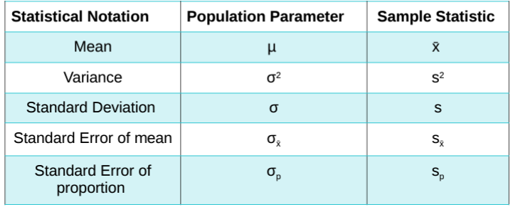
Parameter vs Statistic
A parameter is a number describing a whole population (e.g., population mean), while a statistic is a number describing a sample (e.g., sample mean).
The goal of quantitative research is to understand characteristics of populations by finding parameters. In practice, it’s often too difficult, time-consuming or unfeasible to collect data from every member of a population. Instead, data is collected from samples.
With inferential statistics, we can use sample statistics to make educated guesses about population parameters.

Slide 41
Standard Deviation vs Standard Error
Standard deviation describes variability within a single sample, while standard error describes variability across multiple samples of a population.
Standard deviation is a descriptive statistic that can be calculated from sample data, while standard error is an inferential statistic that can only be estimated.
Standard deviation measures how much observations vary from one another, while standard error looks at how accurate the mean of a sample of data is compared to the true population mean.
The formula for standard deviation calculates the square root of the variance, while the formula for standard error calculates the standard deviation divided by the square root of the sample size.
When to use which one:
Standard deviation is useful when you need to compare and describe different data values that are widely scattered within a single dataset. Because standard deviation measures how close each observation is to the mean, it can tell you how precise the measurements are. So, if you have a dataset forecasting air pollution for a certain city, a standard deviation of 0.89 (i.e. a low standard deviation) shows you that the data is precise.
Standard error is useful if you want to test a hypothesis, as it allows you to gauge how accurate and precise your sample data is in relation to drawing conclusions about the actual overall population. For example, if you want to investigate the spending habits of everyone over 50 in New York City, using a sample of 500 people, standard error can tell you how “powerful” or applicable your findings are.

Slide 42
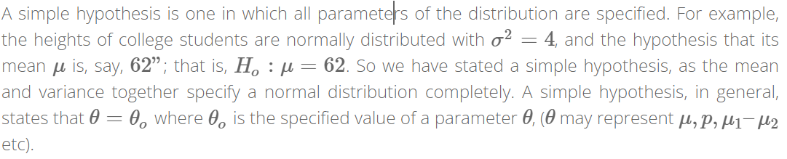
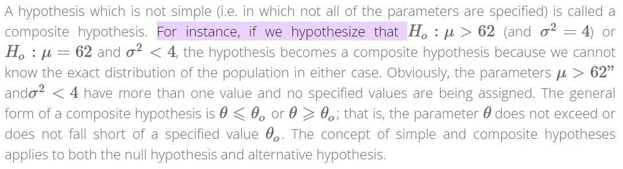
Simple and Composite Hypothesis

Slide 43
Types of Errors-Type I and Type II Error
A type I error (false-positive) occurs if an investigator rejects a null hypothesis that is actually true in the population; a type II error (false-negative) occurs if the investigator fails to reject a null hypothesis that is actually false in the population.
In statistics, a Type I error is a false positive conclusion, while a Type II error is a false negative conclusion.
Making a statistical decision always involves uncertainties, so the risks of making these errors are unavoidable in hypothesis testing.
The probability of making a Type I error is the significance level, or alpha (α), while the probability of making a Type II error is beta (β). These risks can be minimized through careful planning in your study design.
Example: Type I vs Type II error You decide to get tested for COVID-19 based on mild symptoms. There are two errors that could potentially occur:
Type I error (false positive): the test result says you have coronavirus, but you actually don’t.
Type II error (false negative): the test result says you don’t have coronavirus, but you actually do.

Slide 44
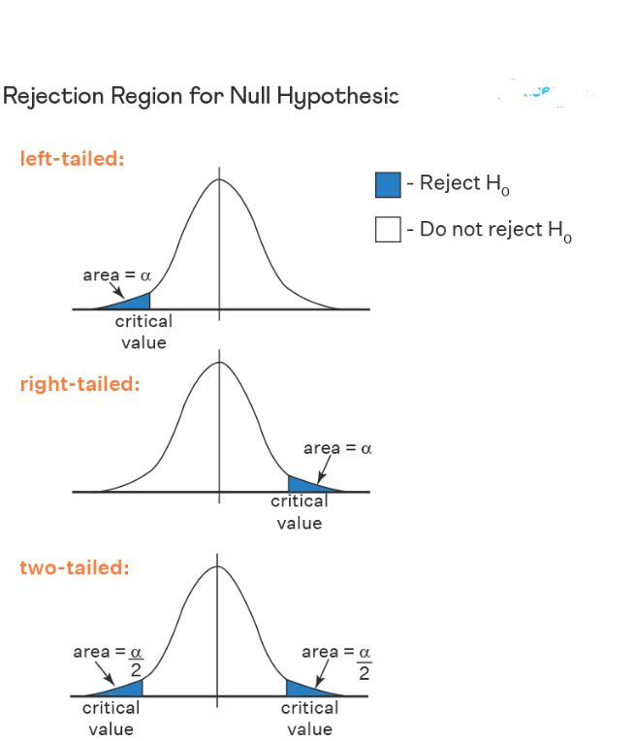
Critical Region
A critical region, also known as the rejection region, is a set of values for the test statistic for which the null hypothesis is rejected. i.e. if the observed test statistic is in the critical region then we reject the null hypothesis and accept the alternative hypothesis.

Slide 45
Test Statistic
In statistics, a test statistic is a numerical summary of a sample that is used to make inferences about a population. It's a crucial component of hypothesis testing and helps you determine whether to accept or reject a null hypothesis based on the data you've collected.
Here's a general overview of how test statistics work in hypothesis testing:
State the Hypotheses: Start by stating your null hypothesis (H0) and alternative hypothesis (Ha). The null hypothesis usually represents the status quo or no effect, while the alternative hypothesis represents the effect you're trying to investigate.
Choose a Test: Depending on your data and research question, you'll choose a specific statistical test. Common examples include t-tests, z-tests, chi-squared tests, ANOVA, and regression analysis.
Collect and Analyze Data: Gather your sample data and perform the necessary calculations to obtain a test statistic. The formula for the test statistic varies based on the chosen test.
Determine the Critical Region: Define a significance level (often denoted by α) that represents the threshold for considering results as statistically significant. This helps you determine the critical region in the distribution of the test statistic.
Compare Test Statistic and Critical Value: Compare the calculated test statistic to the critical value(s) associated with the chosen significance level. If the test statistic falls into the critical region, you reject the null hypothesis in favor of the alternative hypothesis.
Calculate P-value (Optional): In many cases, you can also calculate a p-value associated with the test statistic. The p-value represents the probability of observing a test statistic as extreme as, or more extreme than, the one calculated, assuming that the null hypothesis is true. A low p-value suggests that the null hypothesis is unlikely to be true.
Make a Decision: Based on the comparison of the test statistic and the critical value (or p-value), you make a decision regarding the null hypothesis. If the test statistic is beyond the critical value or the p-value is below the significance level, you reject the null hypothesis. Otherwise, you fail to reject it.
It's important to note that different tests have different test statistics and formulas for calculating them. The choice of test depends on factors like the nature of your data, the research question, and the assumptions underlying the test.
Remember that statistical hypothesis testing involves some complexity and requires careful consideration of assumptions and limitations. It's recommended to have a good understanding of statistical concepts and data analysis techniques before conducting hypothesis tests.

Slide 46
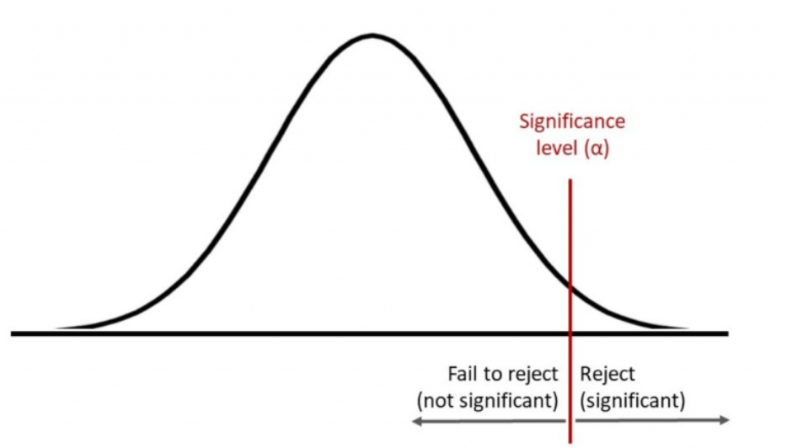
Level of Significance
The level of significance, often denoted as "α" (alpha), is a critical value used in hypothesis testing to determine whether there is enough evidence to reject a null hypothesis.
In hypothesis testing, you have two hypotheses:
Null Hypothesis (H0): This is the default or initial assumption that there is no effect, no difference, or no relationship in the population. It's often stated as the hypothesis to be tested.
Alternative Hypothesis (Ha or H1): This is the hypothesis that contradicts the null hypothesis. It suggests that there is an effect, a difference, or a relationship in the population.
The level of significance represents the threshold for making a decision about the null hypothesis. It helps in determining when to reject the null hypothesis in favor of the alternative hypothesis. Common levels of significance include 0.05 (5%), 0.01 (1%), and 0.10 (10%).

Slide 47
Level of Significance
Here's how it works:
Choose a significance level (α) before conducting the test. This level represents the maximum probability of making a Type I error, which is the incorrect rejection of a true null hypothesis (false positive).
Collect and analyze the sample data.
Calculate the test statistic (such as a t-statistic or z-score) based on the sample data and the statistical test being used.
Compare the calculated test statistic with the critical value(s) from the appropriate statistical distribution (such as the t-distribution or normal distribution). The critical value(s) are determined based on the chosen significance level and the degrees of freedom.
If the calculated test statistic is more extreme than the critical value(s), you would reject the null hypothesis. If it's not as extreme, you would fail to reject the null hypothesis.
Make a decision and draw a conclusion based on the comparison. If you reject the null hypothesis, you would typically support the alternative hypothesis. If you fail to reject the null hypothesis, you do not have enough evidence to support the alternative hypothesis.
Choosing an appropriate significance level is important. A lower significance level reduces the likelihood of making a Type I error but increases the likelihood of making a Type II error (failing to reject a false null hypothesis). The choice of significance level depends on the consequences of making each type of error and the specific context of the problem.

Slide 48
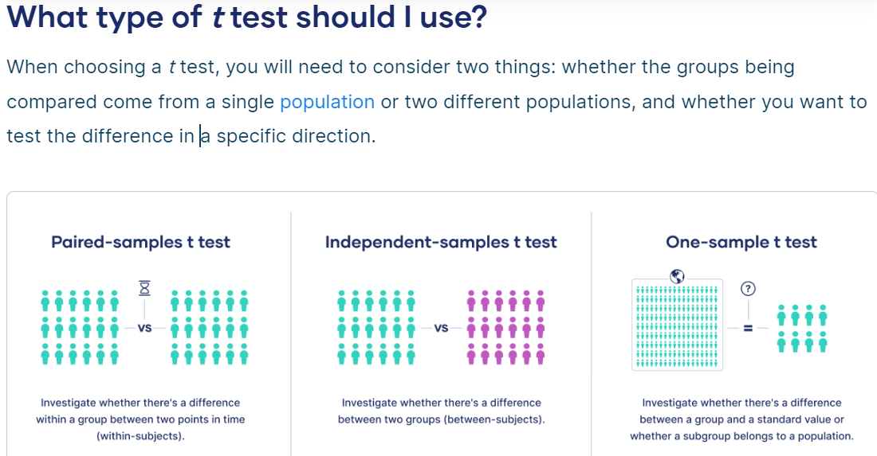
Testing for Mean
A t test can only be used when comparing the means of two groups (a.k.a. pairwise comparison). If you want to compare more than two groups, or if you want to do multiple pairwise comparisons, use an ANOVA test or a post-hoc test.

Slide 49
Testing for Mean
One-sample, two-sample, or paired t test?
If the groups come from a single population (e.g., measuring before and after an experimental treatment), perform a paired t test. This is a within-subjects design.
If the groups come from two different populations (e.g., two different species, or people from two separate cities), perform a two-sample t test (a.k.a. independent t test). This is a between-subjects design.
If there is one group being compared against a standard value (e.g., comparing the acidity of a liquid to a neutral pH of 7), perform a one-sample t test.
One-tailed or two-tailed t test?
If you only care whether the two populations are different from one another, perform a two-tailed t test.
If you want to know whether one population mean is greater than or less than the other, perform a one-tailed t test.
t test example: In your test of whether petal length differs by species:
Your observations come from two separate populations (separate species), so you perform a two-sample t test.
You don’t care about the direction of the difference, only whether there is a difference, so you choose to use a two-tailed t test.

Slide 50
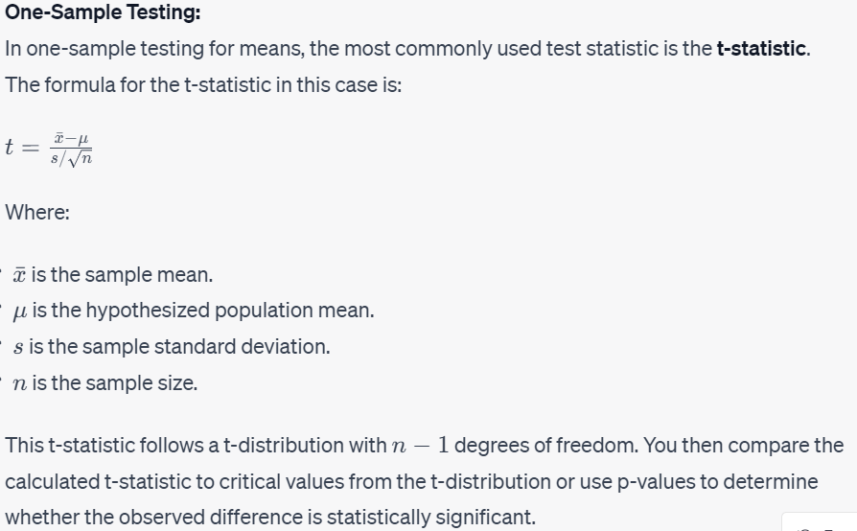

Slide 51
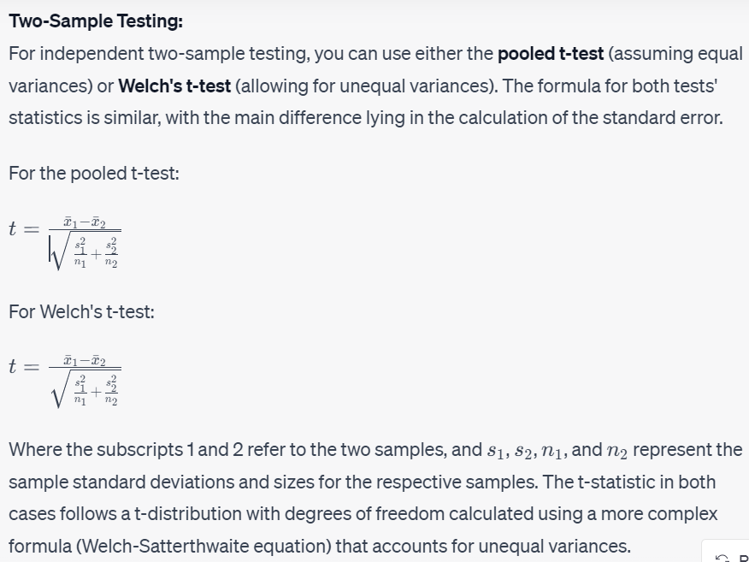

Slide 52
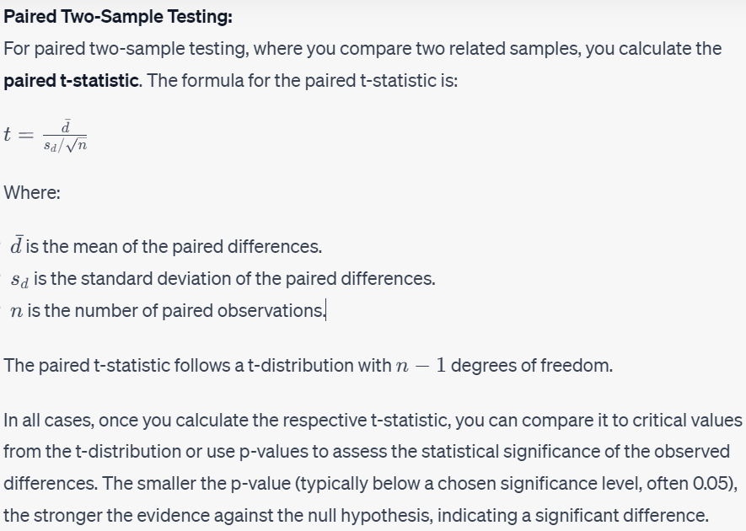

Slide 53
Why does t-distribution have (n-1) degree of freedom?
Imagine you have 4 numbers and the mean of them is 5.
a , b , c , d mean is 5. so you must have 4 numbers that the sum of them is equal to 20.
Now I want to suggest these 4 numbers freely. for the first one I say 5
5 + b + c + d = 20
for next number i suggest 2
5 + 2 + c + d = 20
for the next number i suggest 0
5 + 2 + 0 + d = 20
now for the fourth number (d) I have not the freedom to suggest a number anymore, because the fourth one (d) must be 13.
so you have freedom to choose 3 of them minus 1 of them.
so n-1 is the degree of freedom for measuring the mean of a sample form a population.

Slide 54
Testing for Mean
One-Sample Testing for Mean: One-sample testing is used when you want to compare the mean of a single sample to a known or hypothesized population mean. The process involves comparing the sample mean to the hypothesized population mean and determining whether any observed differences are statistically significant. This is often done using a t-test.
Two-Sample Testing for Mean: Two-sample testing is used to compare the means of two independent samples. The goal is to determine if the observed difference in means between the two samples is statistically significant. The two samples could come from different groups, treatments, or populations. A common example is comparing the exam scores of two different classes to see if there's a significant difference in their average scores.
Paired Two-Sample Testing for Mean: Paired two-sample testing (also known as paired t-test) is used when you want to compare the means of two related or paired samples. The samples are not independent but rather represent measurements taken under different conditions on the same subjects or items. For instance, you might compare the before-and-after weights of individuals who underwent a specific treatment.
In summary:
One-sample testing compares a sample mean to a known or hypothesized population mean.
Two-sample testing compares the means of two independent samples.
Paired two-sample testing compares the means of two related samples.

Slide 55
Chi-Square test of independence
A chi-square (Χ²) test of independence is a nonparametric hypothesis test. They’re used to determine whether your data are significantly different from what you expected. You can use it to test whether two categorical variables are related to each other. If two variables are related, the probability of one variable having a certain value is dependent on the value of the other variable.
The chi-square test of independence calculations are based on the observed frequencies, which are the numbers of observations in each combined group.
The test compares the observed frequencies to the frequencies you would expect if the two variables are unrelated. When the variables are unrelated, the observed and expected frequencies will be similar.
Example: Imagine a city wants to encourage more of its residents to recycle their household waste.
The city decides to test two interventions: an educational flyer (pamphlet) or a phone call. They randomly select 300 households and randomly assign them to the flyer, phone call, or control group (no intervention). They’ll use the results of their experiment to decide which intervention to use for the whole city.
The city plans to use a chi-square test of independence to test whether the proportion of households who recycle differs between the interventions.

Slide 56
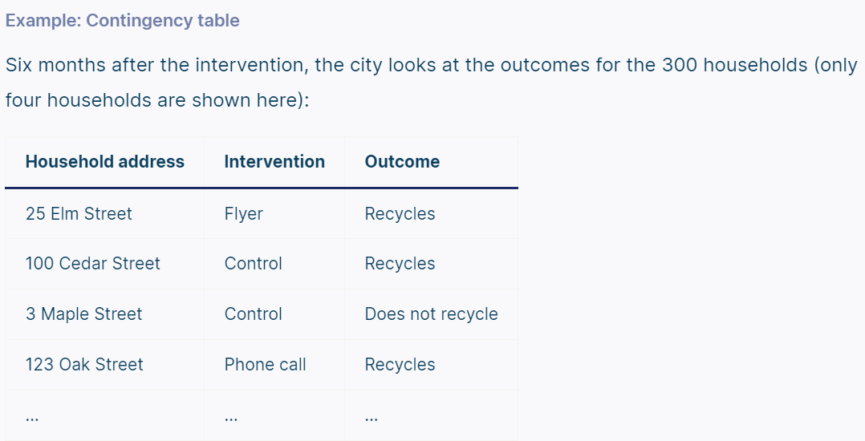
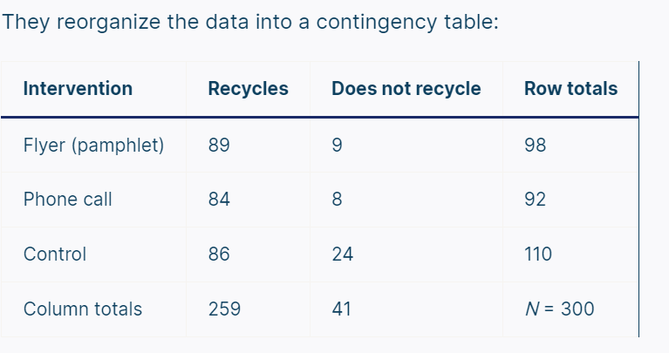
Chi-Square test of independence
Contingency tables
When you want to perform a chi-square test of independence, the best way to organize your data is a type of frequency distribution table called a contingency table.
A contingency table, also known as a cross tabulation or crosstab, shows the number of observations in each combination of groups. It also usually includes row and column totals.

Slide 57
Chi-Square test of independence
Chi-square test of independence hypotheses
The chi-square test of independence is an inferential statistical test, meaning that it allows you to draw conclusions about a population based on a sample. Specifically, it allows you to conclude whether two variables are related in the population.
Like all hypothesis tests, the chi-square test of independence evaluates a null and alternative hypothesis. The hypotheses are two competing answers to the question “Are variable 1 and variable 2 related?”
Null hypothesis (H₀): Variable 1 and variable 2 are not related in the population; The proportions of variable 1 are the same for different values of variable 2.
Alternative hypothesis (H_{a}): Variable 1 and variable 2 are related in the population; The proportions of variable 1 are not the same for different values of variable 2.
The population is all households in the city.
Null hypothesis (H₀): Whether a household recycles and the type of intervention they receive are not related in the population; The proportion of households that recycle is the same for all interventions.
Alternative hypothesis (H_{a}): Whether a household recycles and the type of intervention they receive are related in the population; The proportion of households that recycle is not the same for all interventions.

Slide 58
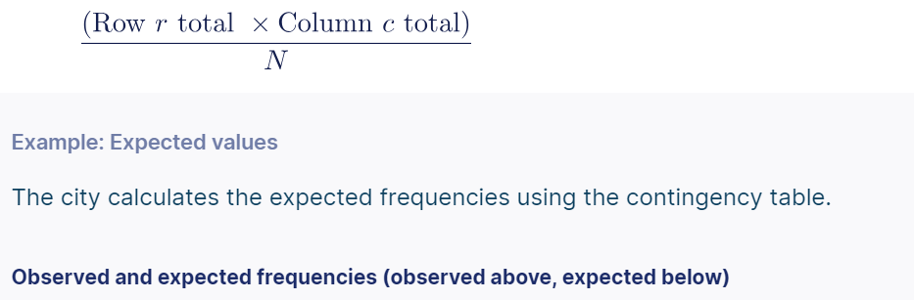
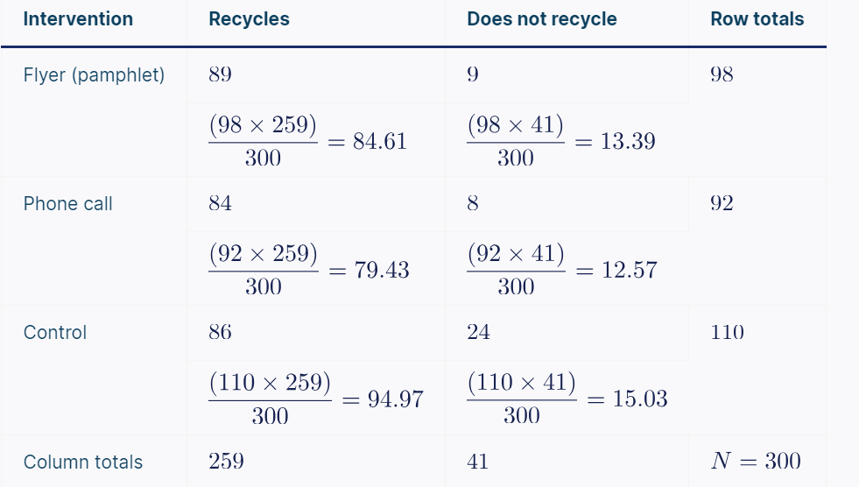
Chi-Square test of independence
Expected values
A chi-square test of independence works by comparing the observed and the expected frequencies. The expected frequencies are such that the proportions of one variable are the same for all values of the other variable.
You can calculate the expected frequencies using the contingency table. The expected frequency for row r and column c is:

Slide 59
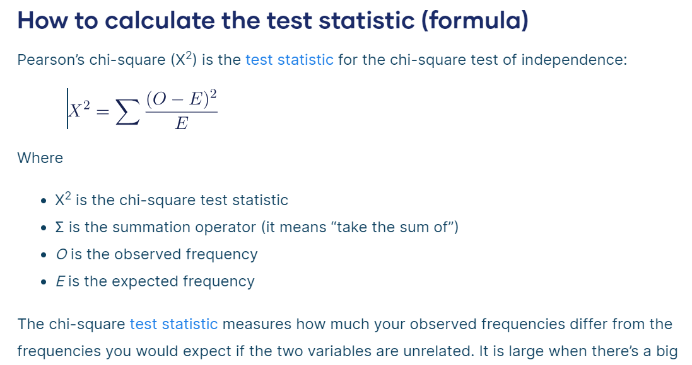
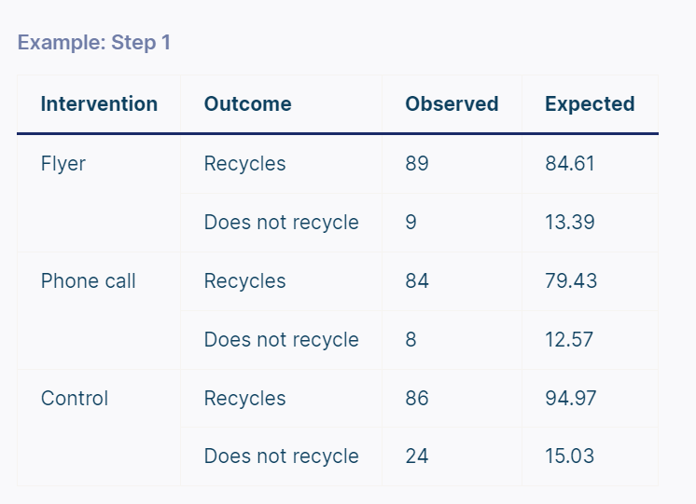
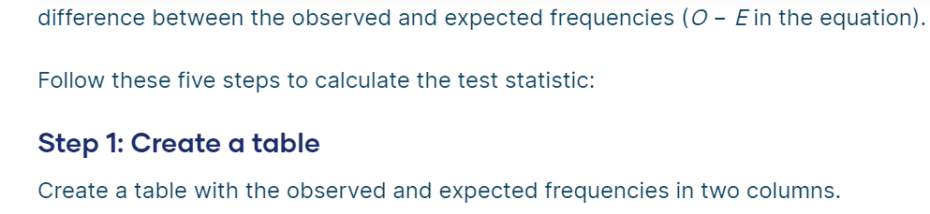
Chi-Square test of independence

Slide 60
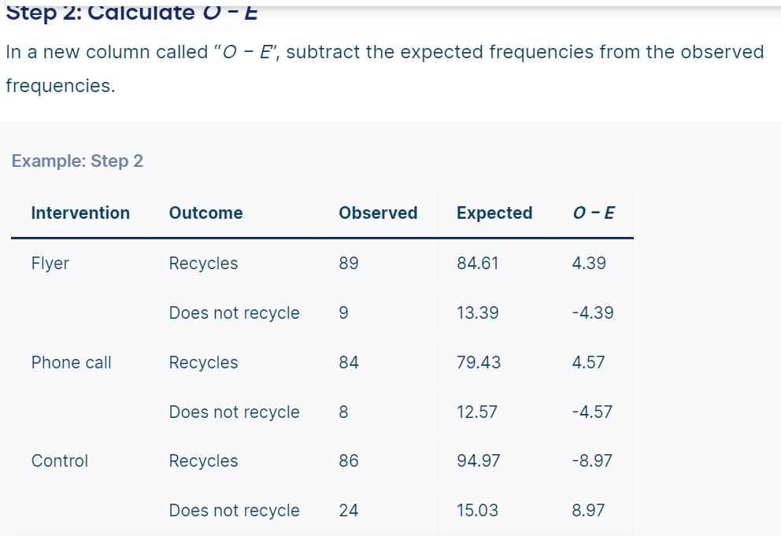
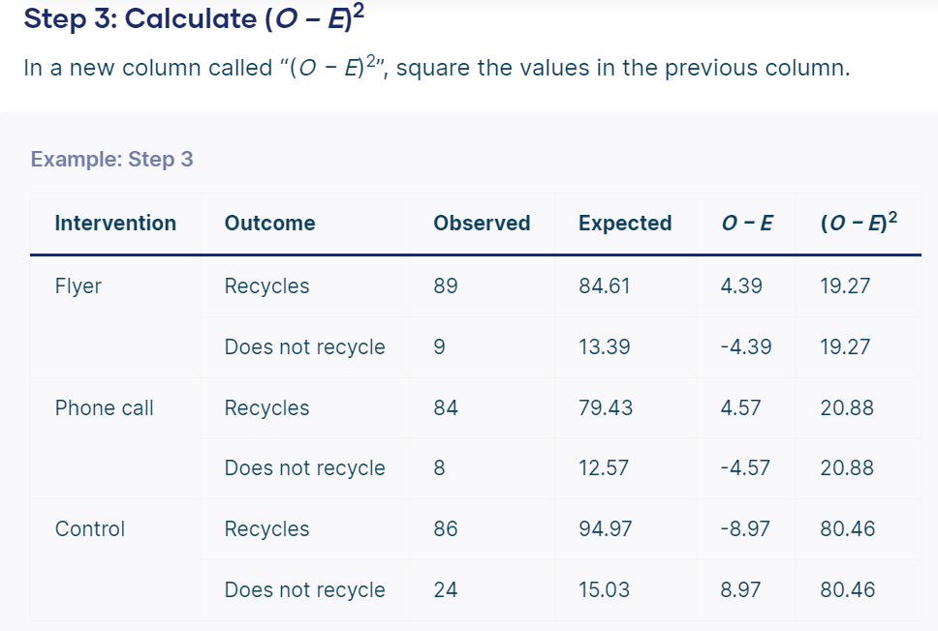
Chi-Square test of independence

Slide 61
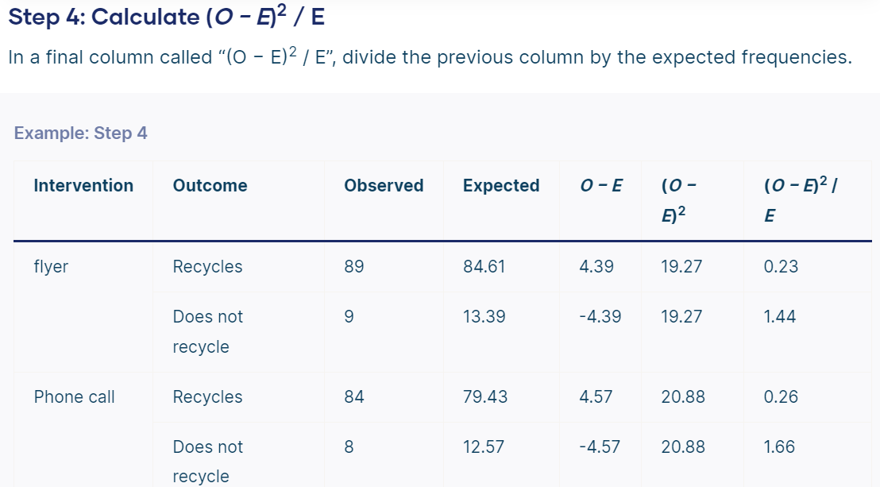
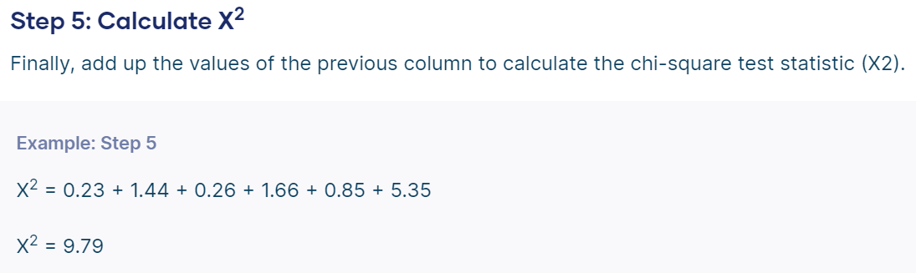

Chi-Square test of independence

Slide 62
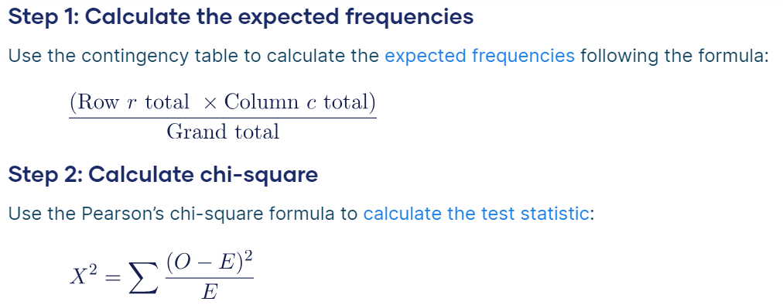
Chi-Square test of independence
How to perform the chi-square test of independence
If the test statistic is big enough then you should conclude that the observed frequencies are not what you’d expect if the variables are unrelated. But what counts as big enough?
We compare the test statistic to a critical value from a chi-square distribution to decide whether it’s big enough to reject the null hypothesis that the two variables are unrelated. This procedure is called the chi-square test of independence.
Follow these steps to perform a chi-square test of independence (the first two steps have already been completed for the recycling example):

Slide 63
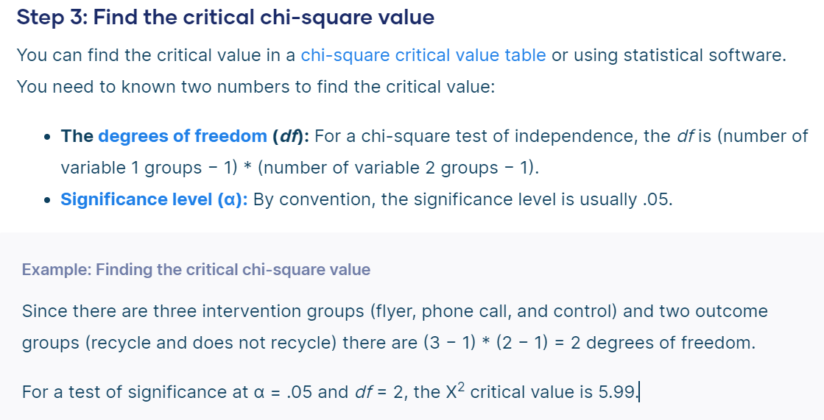
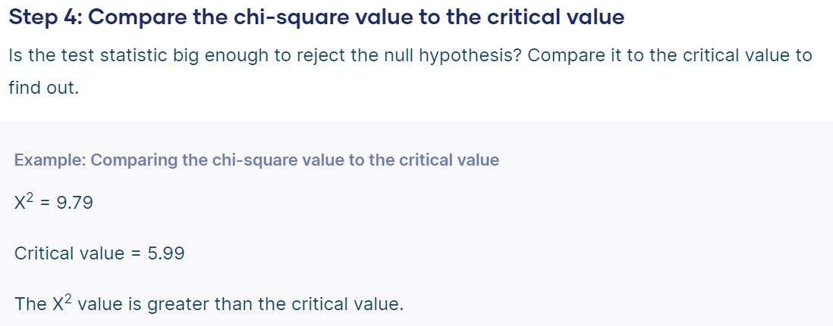
Chi-Square test of independence

Slide 64
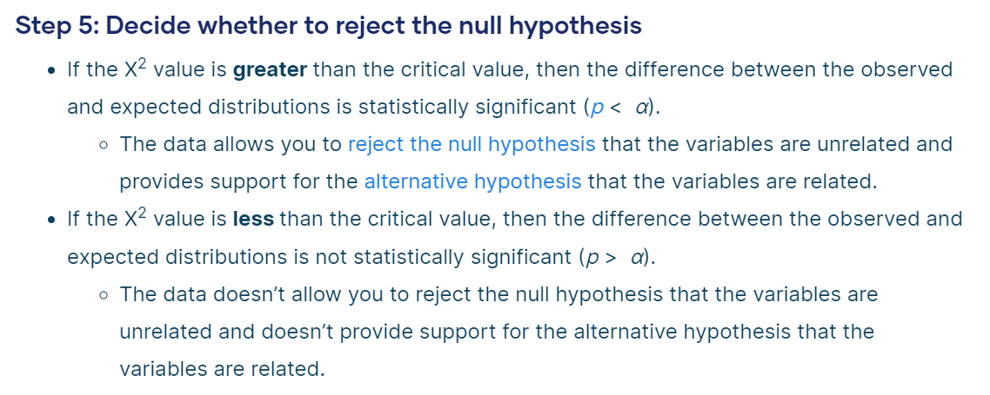

Chi-Square test of independence

Slide 65


Chi-Square Goodness of Fit Test

Slide 66


Chi-Square Goodness of Fit Test

Slide 67


Chi-Square Goodness of Fit Test

Slide 68


Chi-Square Goodness of Fit Test

Slide 69


Chi-Square Goodness of Fit Test

Slide 70


Chi-Square Goodness of Fit Test

